Slide 1
NTE 1010
Introduction to Finance for Engineers
week 4
Management Accounting

Slide 2
Cost – Volume – Profit
Break-Even

Slide 3
NTE 1010 – Introduction to Finance for Engineers
Management Accounting – Cost, Volume, Profit
Costs
Costs represent the resources that have to be sacrificed to achieve a business objective;
in other words, it is spending money for business.
The objective may be to make a particular product, to provide a particular service and so on.
(If the benefit of spending money is realized immediately or up to within a year,
then it is a cost.
On the other hand,
if the benefit is realized over a period longer than one year,
then it is an investment.
The cost of investments are spread out over their useful lives
by a method called depreciation.)
Costs may be classified in many ways;
and, one important way is according to how they behave in relation to
changes in the volume of activity.

Slide 4
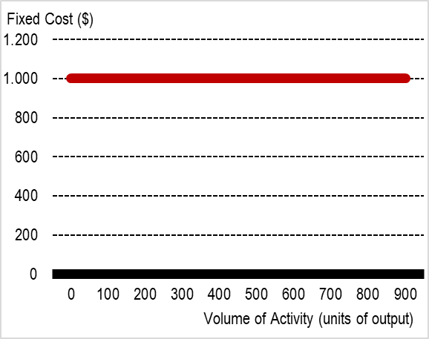
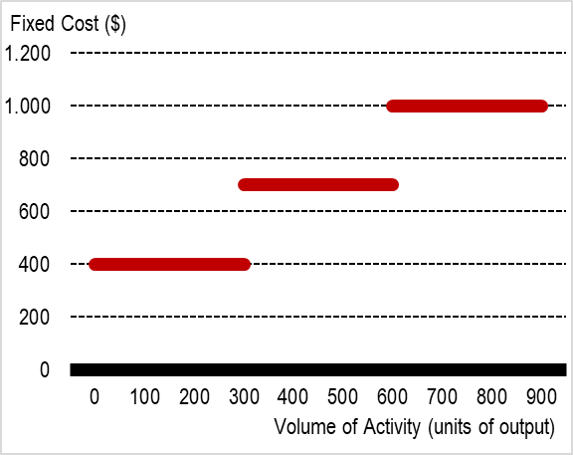
NTE 1010 – Introduction to Finance for Engineers
Management Accounting
Costs
Fixed Costs are
those that are independent of
the level of activity
(for example, rent).
Nevertheless,
as the volume of activity increases,
at a particular point,
the volume of activity cannot increase further
without additional fixed cost
such as renting additional space.
Fixed costs that behave like this are often referred to as Stepped Fixed Costs.

Slide 5
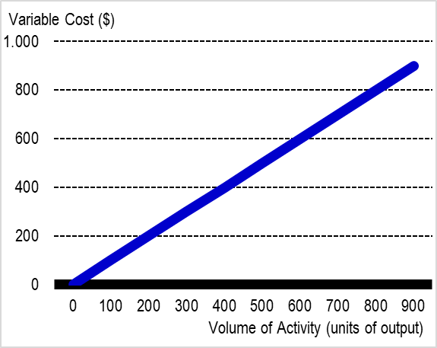
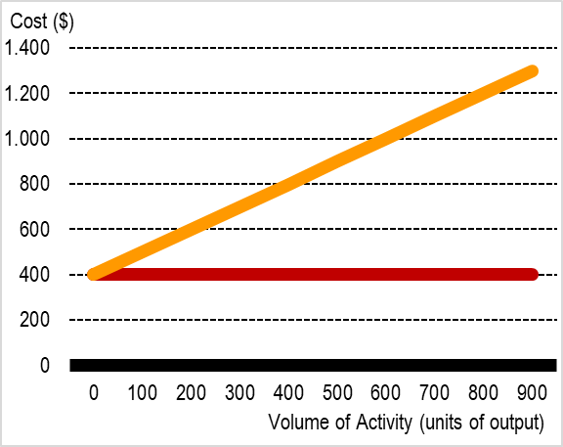





NTE 1010 – Introduction to Finance for Engineers
Management Accounting
Costs
Variable Costs are
those that vary with
the level of activity
(for example, raw materials).
Total Costs = Fixed Costs + Variable Costs
Semi-fixed (semi-variable) costs are
a mixture of the two (for example, electricity).

Slide 6
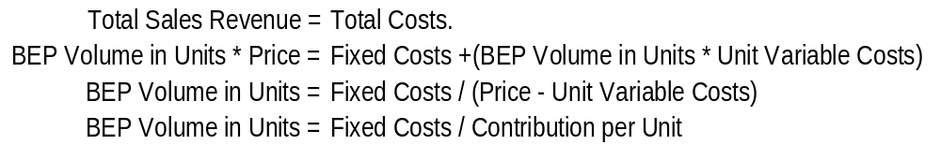
NTE 1010 – Introduction to Finance for Engineers
Management Accounting – Cost, Volume, Profit
Break-Even Analysis
The break-even point (BEP) is the level of activity (in units of output or sales revenue)
at which total costs (fixed +variable) = total sales revenue.
          At BEP,
(Price - Unit Variable Costs) is called "contribution",
because it contributes to meeting the fixed costs and,
if there is any excess, it also contributes to profit.
Knowledge of BEP for a particular activity can be used as a basis for risk assessment.
Planning to operate only just above the Break-Even Volume of Activity
may indicate that it is a risky venture,
since only a small fall from the planned / expected volume of activity could lead to a loss.

Slide 7
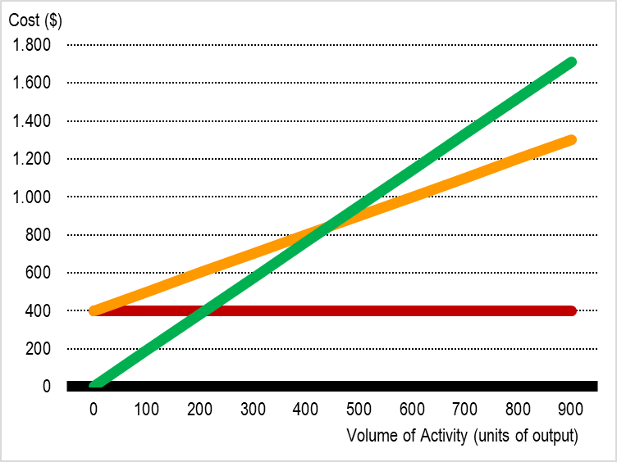


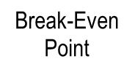
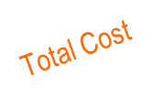

NTE 1010 – Introduction to Finance for Engineers
Management Accounting – Cost, Volume, Profit
Break-Even Analysis
The break-even point (BEP) is
the level of activity (in units of output or sales revenue)
at which total costs (fixed +variable) = total sales revenue.

Slide 8
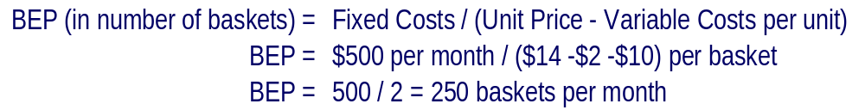
NTE 1010 – Introduction to Finance for Engineers
Management Accounting – Cost, Volume, Profit
Break-Even Analysis
Cottage Industries Ltd makes baskets.
The fixed costs of operating the workshop for a month total $500.
Each basket requires materials that cost $2.
Each basket takes one hour to make, and the business pays the basket makers $10 an hour.
The basket makers are all on contracts such that
if they do not work for any reason, they are not paid.
The baskets are sold to a wholesaler for $14 each.
What is the Break-Even Point (BEP) for basket making for the business?

Slide 9
NTE 1010 – Introduction to Finance for Engineers
Management Accounting – Cost, Volume, Profit
Break-Even Analysis: Margin of Safety
Margin of Safety = excess of planned volume of activity over BEP / planned volume of activity
Margin of Safety = (600-420) / 600 = 30%

Slide 10
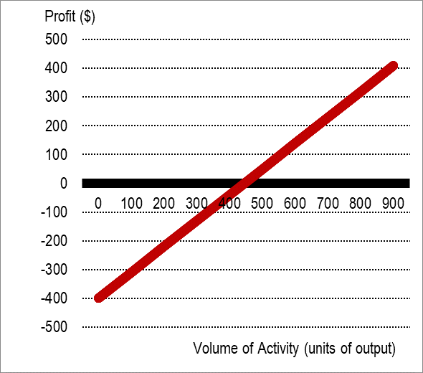
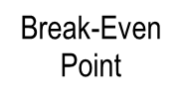



NTE 1010 – Introduction to Finance for Engineers
Management Accounting – Cost, Volume, Profit
Break-Even Analysis
Profit-volume (PV) chart is an alternative approach to the BE chart.

Slide 11
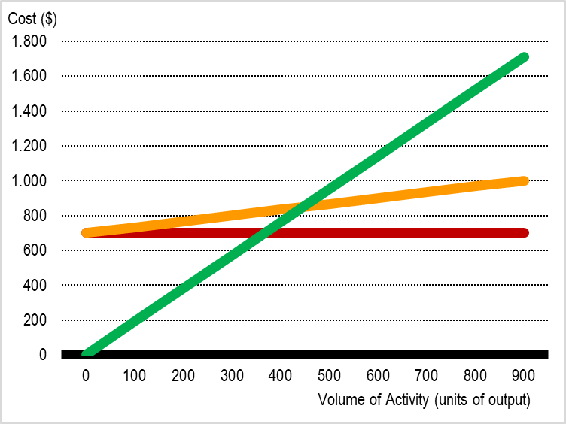


NTE 1010 – Introduction to Finance for Engineers
Management Accounting – Cost, Volume, Profit
Break-Even Analysis
Operating gearing = the extent to which the total costs of some activity are fixed rather than variable.
An activity with relatively high fixed costs compared with its variable costs
is said to have higher operating gearing.
higher operating gearing
Loss

Slide 12
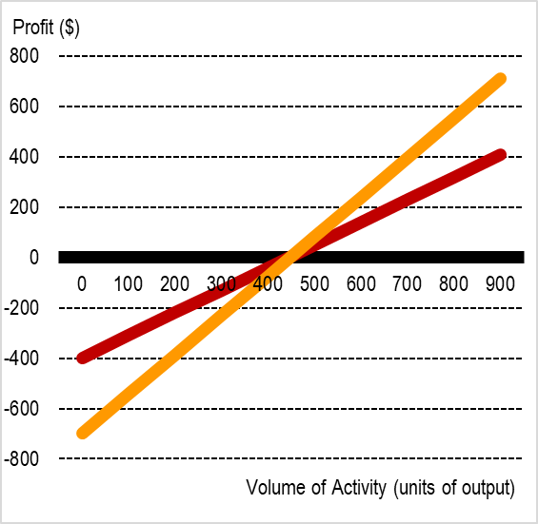

NTE 1010 – Introduction to Finance for Engineers
Management Accounting – Cost, Volume, Profit
Break-Even Analysis
Operating gearing = the extent to which the total costs of some activity are fixed rather than variable.
Increasing the level of operating gearing tends to make profits
more sensitive to changes in the volume of activity.
-700

Slide 13
NTE 1010 – Introduction to Finance for Engineers
Management Accounting – Cost, Volume, Profit
Weaknesses of Break-Even Analysis
Non-linear relationships:
  The basic Break-Even analysis assumes that the relationships between sales revenues, variable costs and volume are linear ones; in real life, this unlikely to be so.
Stepped fixed costs:
  Most fixed costs such as rent, supervisory salaries, and administration costs are not fixed over all volumes of activity in real life.
Multi-product businesses:
  Fixed costs tend to relate more than one activity; while there are ways of dividing fixed costs between activities, these tend to be arbitrary.

Slide 14
NTE 1010 – Introduction to Finance for Engineers
Management Accounting – Cost, Volume, Profit
Marginal Analysis
(ignores fixed costs where these are not affected by the decision):
Accepting/rejecting special contracts
  - consider only the effect on contributions.
  Since the fixed costs will be incurred in any case, they are not relevant. We need to see whether the price offered by the special contract will yield a contribution, i.e. Price - Unit Variable Cost.
Using scarce resources
  - the limiting factor is most effectively used by maximising its contribution per unit.
  We tend to think in terms of the size of the market being the brake on output.
  This is to say that the ability of a business to sell will limit production, rather than the ability to produce will limit sales. In some cases, however, it is a limit on what can be produced that limits sales.
  Limited production might stem from a shortage of any factor of production
  - labour, raw materials, space, machinery and so on.
Make-or-buy decisions (outsourcing / subcontracting)
  - take the action that leads to the highest total contributions.
  Compare the variable cost of subcontracting to variable cost of internal manufacture.
Closing/continuing an activity
  - should be assessed by net effect on total contributions.
  For a department that is making loss, if it is making positive contribution before allocated fixed costs,
  it should not be closed.
  Because the allocated fixed costs would continue whether the department were closed or not.

Slide 15
Full Costing

Slide 16
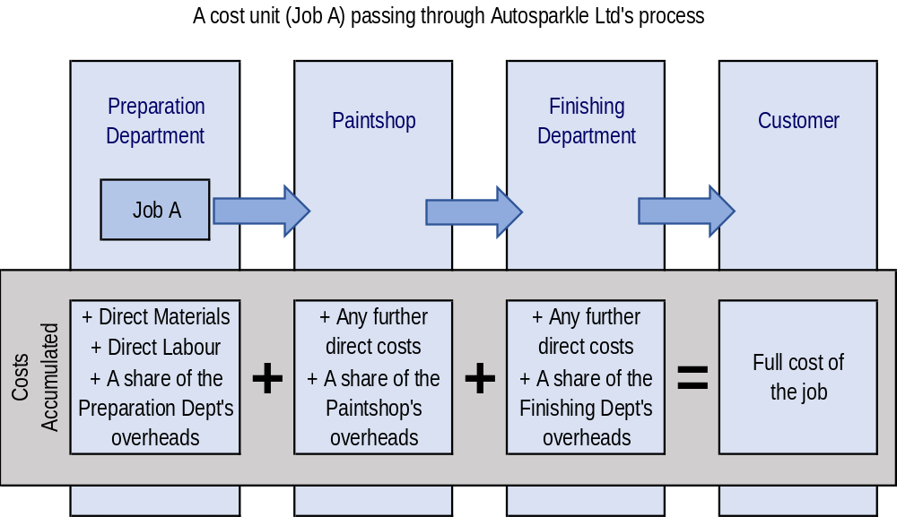
NTE 1010 – Introduction to Finance for Engineers
Management Accounting – Full Costing
Full cost = the total amount of resources sacrificed to achieve a particular objective
To derive the full cost figure,
we must accumulate the costs incurred and then assign them to the particular product or service.

Slide 17
NTE 1010 – Introduction to Finance for Engineers
Management Accounting – Full Costing
Single Product Operations
Full cost = the total amount of resources sacrificed to achieve a particular objective
To derive the full cost figure,
we must accumulate the costs incurred and then assign them to the particular product or service.
Single-product operations:
Where all the units of output are identical,
the full cost can be calculated as follows:
Cost per unit = Total cost of output / Number of units produced

Slide 18
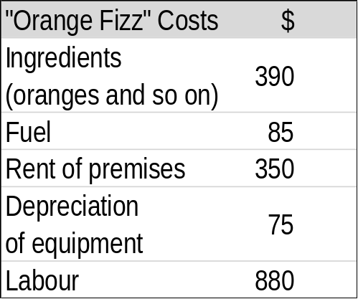
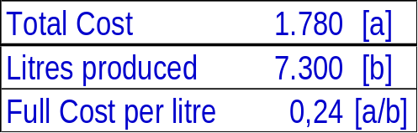
NTE 1010 – Introduction to Finance for Engineers
Management Accounting – Full Costing
Single Product Operations
Fruitjuice Ltd has just one product, a sparkling orange drink that is marketed as "Orange Fizz". During last month, the business produced 7,300 litres of the drink.
The costs incurred were as follows:
What is the full cost per litre of producing "Orange Fizz"?
This figure is found by simply adding together all of the costs incurred
and then dividing by the number of litres produced.

Slide 19
NTE 1010 – Introduction to Finance for Engineers
Management Accounting – Full Costing
Multi-Product Operations
Where units of output are not identical,
it is necessary to divide the costs into two categories: direct costs and indirect costs.
Direct costs = costs that can be identified with specific cost units
(for example, labour of a garage mechanic in relation to a particular car repair).
Indirect costs (overheads) = costs that cannot be directly measured in respect of a particular job
(for example, rent of a garage)
Full cost = direct cost +indirect cost.
Direct/indirect is not linked to variable/fixed.
Indirect costs are difficult to relate to individul cost units - arbitrary bases are used
and there is no single correct method.
Traditionally, indirect costs are seen as the costs of providing a "service" to cost units.
Direct labour hour basis of applying indirect costs to cost units
is the most popular in practice.

Slide 20
NTE 1010 – Introduction to Finance for Engineers
Management Accounting – Full Costing
Overhead Costs
Dealing with overheads on a departmental basis:
Indirect costs can be segmented
usually on a departmental basis - each department has its own overhead recovery rate.
Each department is a separate cost centre
that is an area, activity or function for which costs are separately collected.

Slide 21
NTE 1010 – Introduction to Finance for Engineers
Management Accounting – Full Costing
Batch Costing / Activity-Based Costing
Batch Costing: A variation of job costing
where each job consists of a number of identical (or near identical) cost units:
Cost per unit = Cost of the batch (direct +indirect) / Number of units in the batch
If the full cost is charged as the sales price and things go according to plan,
the business will break even.
Activity-based costing (ABC) is an approach to dealing with overheads (in full costing)
that treats all costs as being caused or "driven" by activities.
While in traditional approach, overhead costs are allocated on the basis of a parameter,
in ABC approach, overhead costs are charged on the basis of activities.
Advocates argue that it is more relevant to the modern commercial environment
than is the traditional approach.
Identification of the cost drivers can lead to more relevant indirect cost treatment in full costing.
Identification of the cost drivers can lead to better control of overheads.
Critics argue that ABC is time-consuming and expensive to apply,
not justified by the possible improvement in the quality of information.

Slide 22
NTE 1010 – Introduction to Finance for Engineers
Management Accounting – Full Costing
Activity-Based Costing
Modern Producers Ltd runs, like virtually all manufacturers, finished goods stores.
The business has two product lines, A and B.
Product A tends to be made in small batches and so low levels of finished goods inventories are held.
Product B is supllied in relatively large quantities instantly. As a consequence,
much of the finished goods stores is filled with Product B ready to be dispatched as an order is received.
Traditionally, the cost of of operationg the stores (an overhead cost) are allocated to products A and B
according to the number of direct labour hours worked on each one.
And, that did not seem fair to the new accountant Modern Producers Ltd.
He estimated that the costs of running the finished goods stores for the next year will be 90,000$.
It is also estimated that each unit of Product A will spend an average of 1 week in the stores before being sold.
With Product B, the equivalent period is 4 weeks.
Both products are of roughly similar size and have very similar storage needs.
It is estimated that next year 50,000 units of Product A and 25,000 units of Product B will pass through the stores.
The new accountant wants to allocate the overhead cost of running the finished goods stores to products A and B
according to Activity-Based Costing
with the quantity of products and the time spent in the stores as the cost drivers.

Slide 23
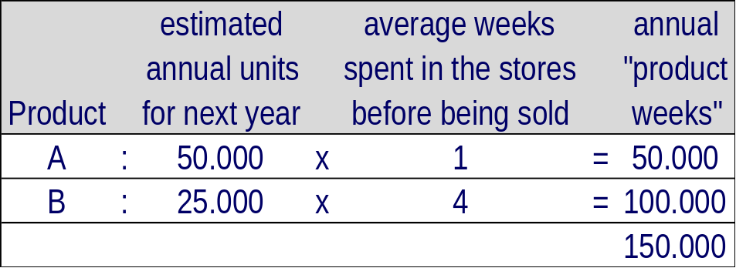
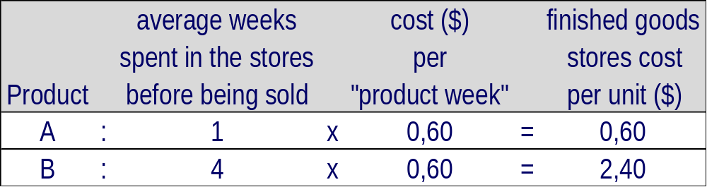
Activity-Based Costing
He estimated that the costs of running the finished goods stores for the next year will be 90,000$.
It is also estimated that each unit of Product A will spend an average of 1 week in the stores before being sold.
With Product B, the equivalent period is 4 weeks.
Both products are of roughly similar size and have very similar storage needs.
It is estimated that next year 50,000 units of Product A and 25,000 units of Product B will pass through the stores.
The new accountant wants to allocate the overhead cost of running the finished goods stores to products A and B
according to Activity-Based Costing
with the quantity of products and the time spent in the stores as the cost drivers.
The total number of "product weeks" in the stores will be:
The finished goods store cost per "product week" is given by 90,000$ / 150,000 product weeks = 0.60$
Therefore each unit of product A and product B will be charged as follows:

Slide 24
NTE 1010 – Introduction to Finance for Engineers
Management Accounting – Full Costing
Pricing (full cost) on a cost-plus basis.
In some industries and circumstances, full costs are used as the basis of pricing.
Here, the full cost is deduced and a percentage is added for profit.
This is known as cost-plus pricing.
Vehicle repair shops typically operate this way.
Lawyers and accountants doing work for clients often use this approach as well.
Income measurement.
Where a service is partially rendered in one accounting period
but the revenue is realised in the next,
Full-Costing information may be useful in assessing profitability.
Full cost information is seen by some as not very useful
because it can be backward looking.

Slide 25
Budgeting

Slide 26
NTE 1010 – Introduction to Finance for Engineers
Management Accounting – Budgeting
  Budget = a short-term business plan, mainly expressed in financial terms.
  Budgets are the short-term means of working towards the business's objectives.
  Usually for 12 months with subperiods of a month.
  Uses are to:
    promote forward thinking
    help coordinate the various aspects
    motivate performance
    provide the basis of a system of control
    provide a system for authorisation
  Preparing budgets:
  There is no standard style - practicality and usefulness are the key issues.
  They are usually prepared in columnar form,
  with a column for each month (or similarly short period).
  Each budget must link (coordinate) with others.

Slide 27
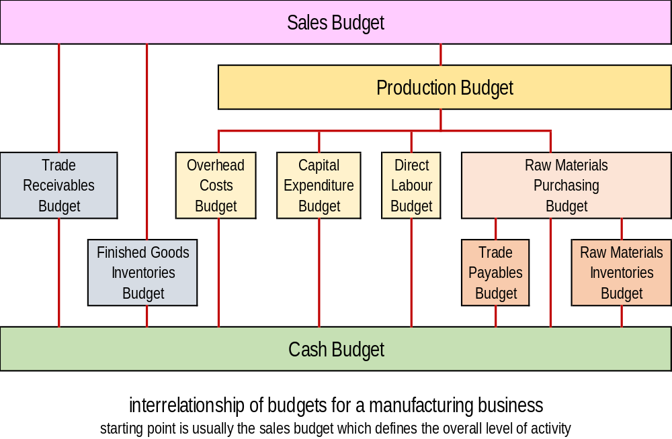
NTE 1010 – Introduction to Finance for Engineers
Management Accounting – Budgeting

Slide 28
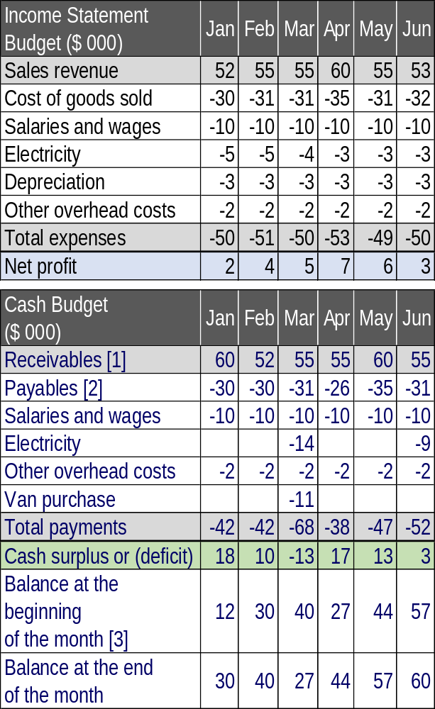
Vierra Popova Ltd is a wholesale business.
The budgeted income statements for each of the net six months are as follows:
The business allows all of its customers one month's credit. Sales revenue during December totalled 60,000$.
The business plans to maintain inventories at their existing level until some time in March, when they are to be reduced by 5,000$. Inventories will remain at this lower level indefinitely.
Inventories purchases are made on one month's credit. December purchases totalled 30,000$.
Salaries, wages and "other overhead costs" are paid in the month concerned.
Electricity is paid quarterly in arrears in March and June.
The business plans to buy and pay for a new delivery van in March. This will cost a total of 15,000$, but an existing van will be traded in for 4,000$ as part of the deal.
The business expects to have 12,000$ in cash at the beginning of January.
Please prepare the cash budget for the six months ending in June.
[1] The cash receipts from trade receivables lag a month behind sales, because customers are given a month in which to pay for their purchases. So, December sales will be paid for in January and so on.
[2] In most months, purchases of inventories will equal the cost of goods sold. This is because the business maintains a constant level of inventories. For inventories to remain constant at the end of each month, the business must replace eactly the amount that has been used.
During March, however, the business plans to reduce its inventories by 5,000$. this means that inventories purchases will be lower than inventories usage that month. The payments for inventories purchases lag a month behind purchases because the business expects to be allowed a month to pay for what it buys.
[3] Each month's cash balance is the previous month's figure plus the cash surplus (or minus the cash deficit) for the current month. Th ebalance at the start of January is 12,000$ according to the information provided earlier.
[4] Depreciation does not give rise to a cash payment.

Slide 29
NTE 1010 – Introduction to Finance for Engineers
Management Accounting – Budgeting
Trade Receivables Budget:
Balance at the beginning of the month + Sales revenue - Cash receipts
= Balance at the end of the month
Trade Payables Budget:
Balance at the beginning of the month + Purchases - Cash payments
= Balance at the end of the month
Inventories Budget:
Balance at the beginning of the month + Purchases - Inventories used
= Balance at the end of the month

Slide 30
NTE 1010 – Introduction to Finance for Engineers
Management Accounting – Budgeting
Controlling through Budgeting
Flexing the budget to match actual volume of output.
Variance = increase (favourable) or decrease (adverse) in profit, relative to the budgeted profit,
as a result of some aspect of the business's activities taken alone.
Budgeted profit plus all favourable variances less all adverse variances equals actual profit.
Commonly calculated variances:
  Sales volume variance = difference between budgeted and actual volume (in units) multiplied by the contribution per unit
  Sales price variance = difference between actual sales revenue and actual volume at the budgeted sales price per unit
  direct materials usage variance = difference between actual usage and budgeted usage, for the actual volume of output, multiplied by the budgeted material cost per unit of material
  direct material price variance = difference between the actual material cost and the actual usage multiplied by the budgeted cost per unit of material
  direct labour efficiency variance = difference between actual labour time and budgeted time, for the actual volume of output, multiplied by the budgeted labour rate
  direct labour rate variance = difference between the actual labour cost and the actual labour time multiplied by the budgeted labour rate
  fixed overhead spending variance = difference between the actual and budgeted spending on fixed overheads

Slide 31
NTE 1010 – Introduction to Finance for Engineers
Management Accounting – Budgeting
Controlling through Budgeting
Standards = budgeted physical quantities and financial values for one unit of inputs and outputs.
Standards are useful in providing data for decision making.
Significant and/or persistent variances need to be investigated to establish their cause.
Good budgetary control requires establishing systems and routines to ensure such things as clear distinction between individual managers' areas of responsibility, prompt, frequent and relevant variance reporting and senior management commitment.
Not all activities can usefully be controlled through traditional variance analysis.
    Expenses such training and advertising are discretionary and not linked to the level of output in a direct way.
    Standards can quickly become out of date as a result of technological change.
    Sometimes factors that are outside the control of the manager concerned can affect the calculation of the variance for which the manager is held accountable; this should be taken into account.
    In practice, creating clear lines of demarcation between the areas of responsibility of various managers may be difficult.
There is a behavioural aspect of control, which should be taken into accountnby senior managers.
    Examples, performance improvement, motivation, participation improves performance and motivation.

Slide 32
NTE 1010
Introduction to Finance for Engineers
Spring 2020 - Week 4
Homework 1

Slide 33
NTE 1010 – Introduction to Finance for Engineers
Homework-1
Analysis of Financial Statements
  Find 2017, 2018 and 2019 year-end Financial Statements of a company
      shares of which are being traded in İstanbul Stock Exchange.
      Attach copies of those statements to your homework and state the source of the information.
    Afterwards, choose 3 ratio classifications out of
      [1] Profitability, [2] Efficiency, [3] Liquidity, [4] Financial leverage, [5] Investment.
      And then, pick a ratio in each one; state the formulas of each ratio that you picked.
  Calculate 2018 and 2019 values for these 3 ratios that you picked.
  Comment for each ratio whether the company performed better or worse in 2019 compared to 2018
      and explain why so.
    You may do your homework in groups (of max 3 students) if you wish.
    The homework should either be a computer printout or a legible handwriting.
    At the top, it must have the following heading:
        ″NTE 1010 Introduction to Finance for Engineers, Spring 2020, Homework-1″
        followed by your name(s), family name(s), and student ID no(s).
  Homework-1 is to be handed-in two weeks later, on Wednesday, March 25th in the class.
  Each homework is worth 6% of your course grade.
  Do not copy the work of somebody else.

